Slide 1


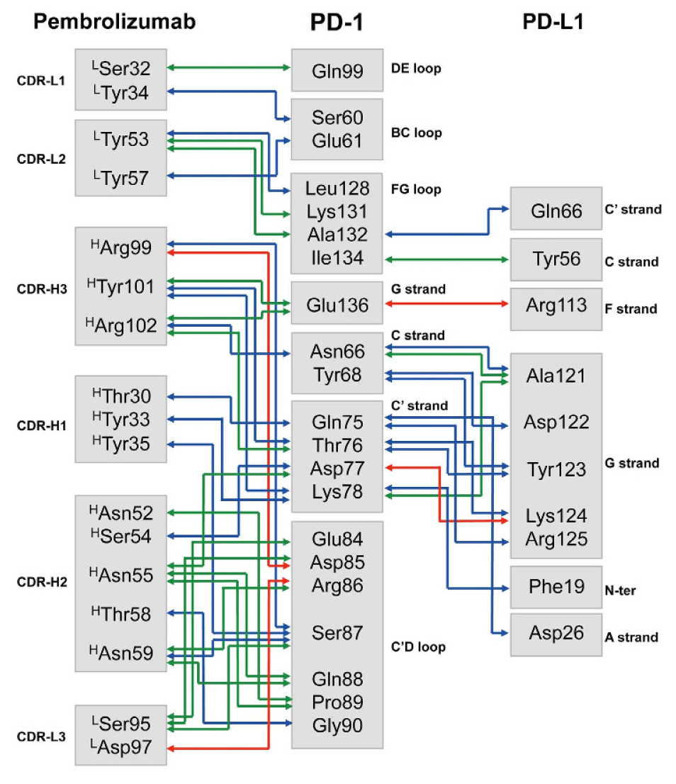
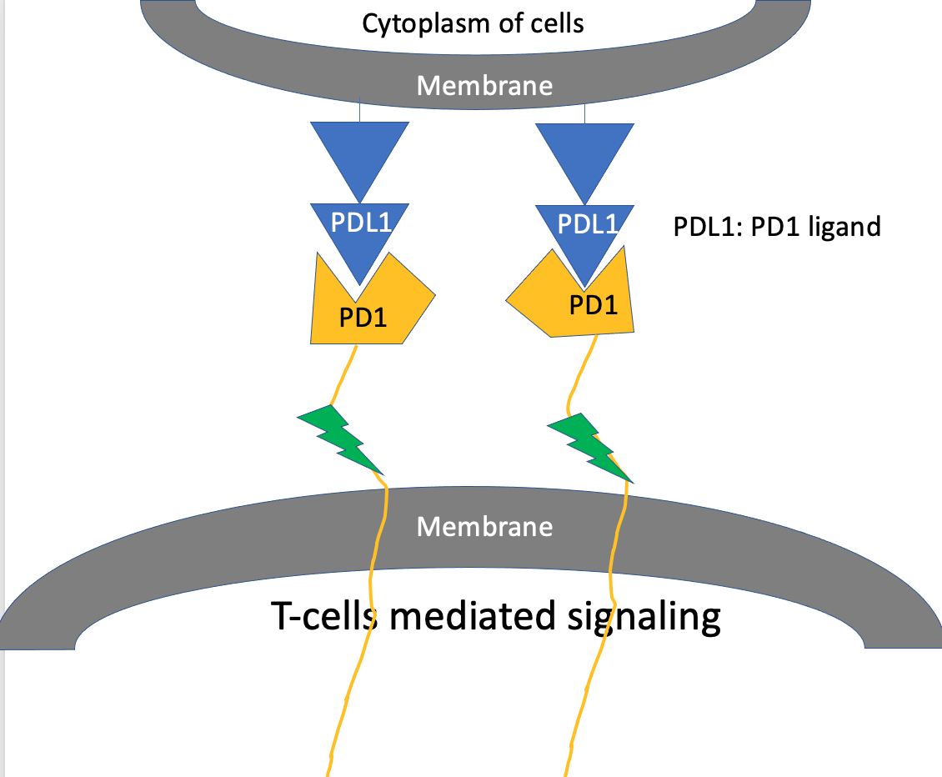
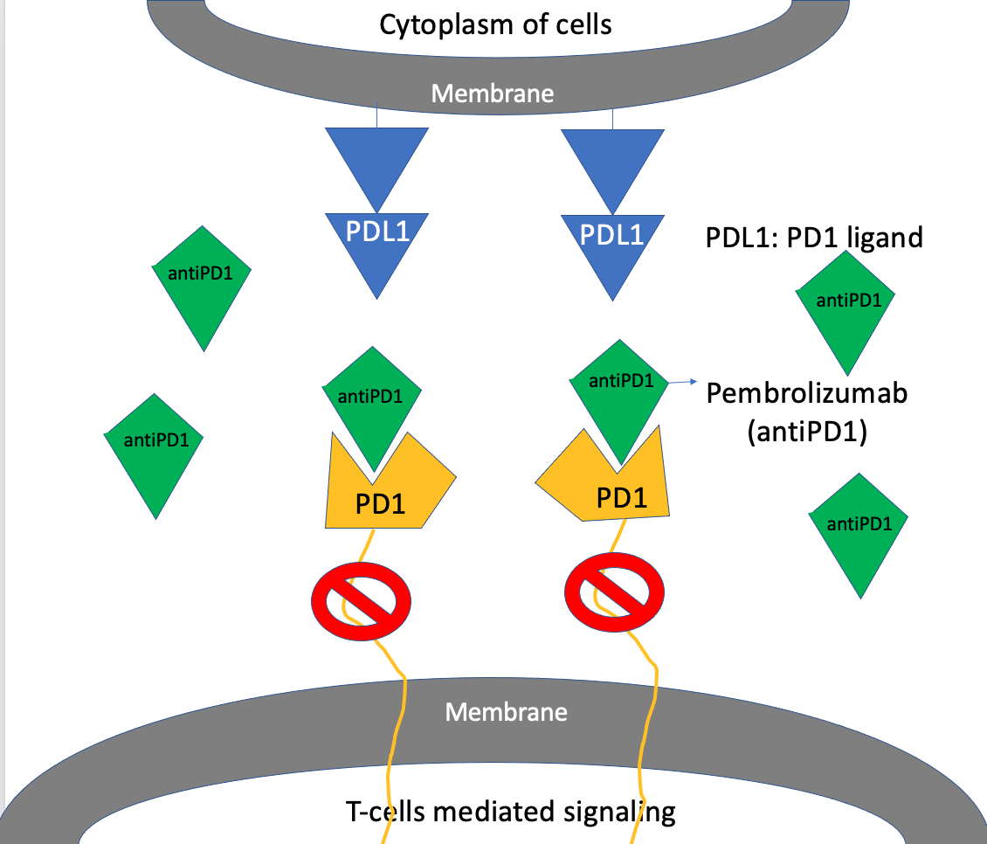
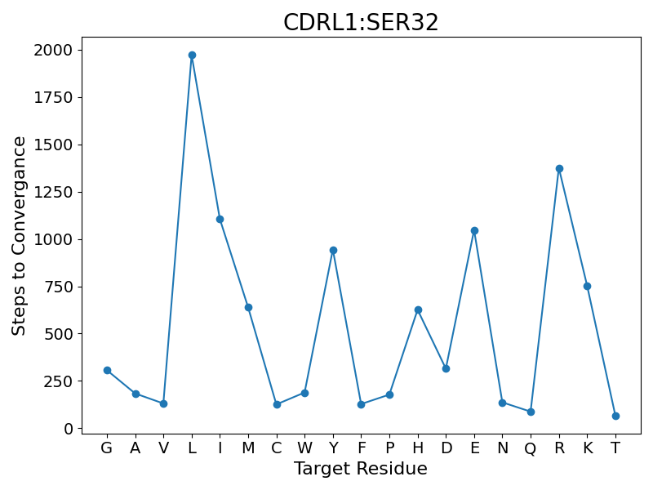
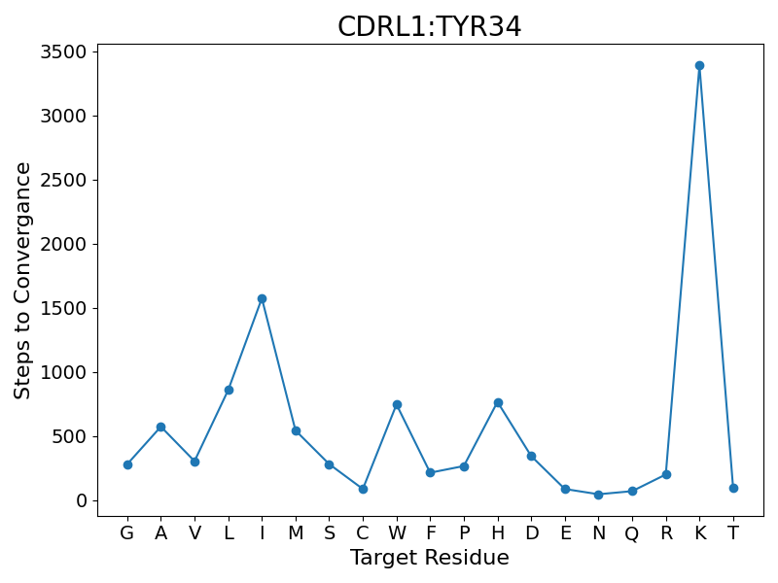
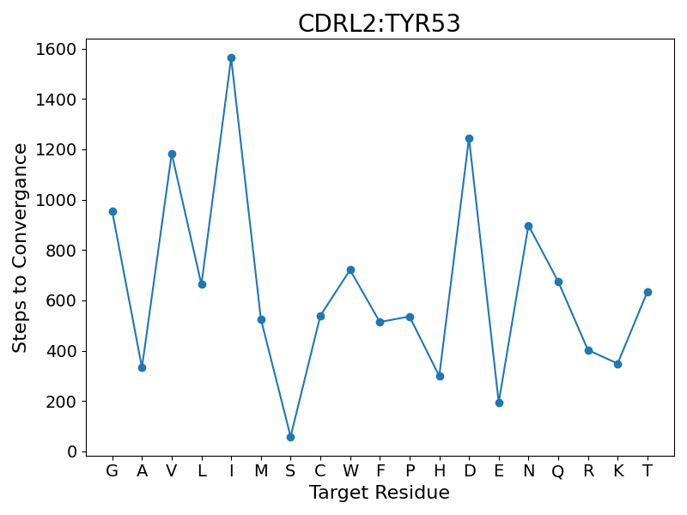
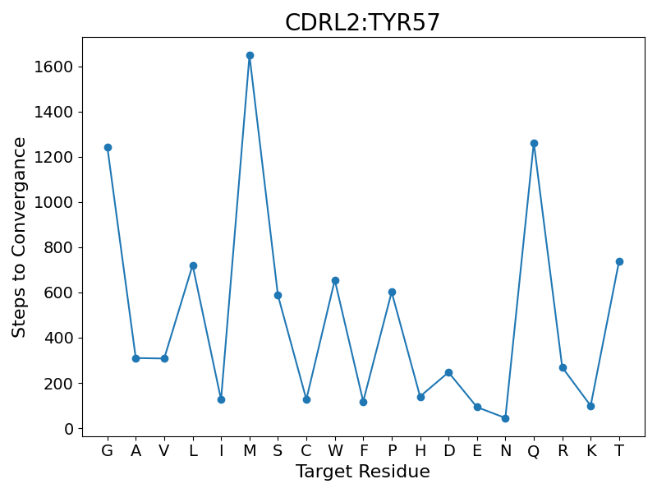
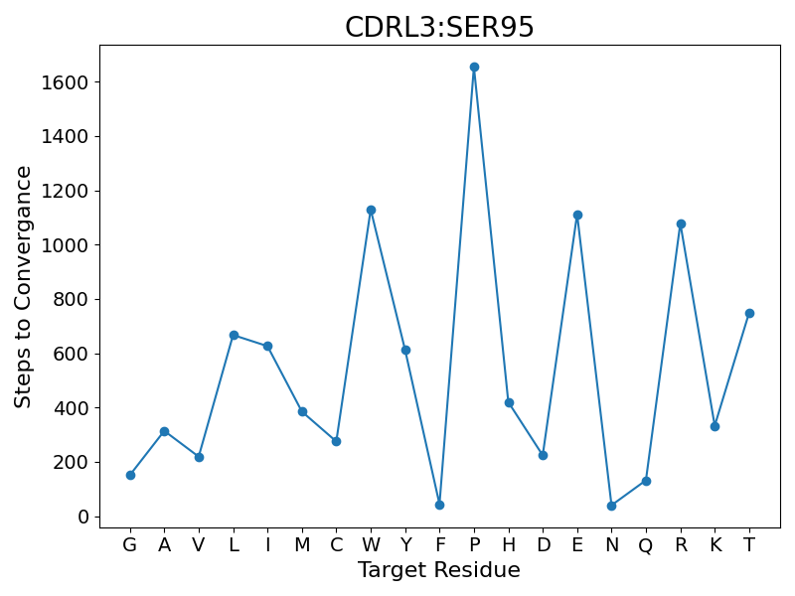
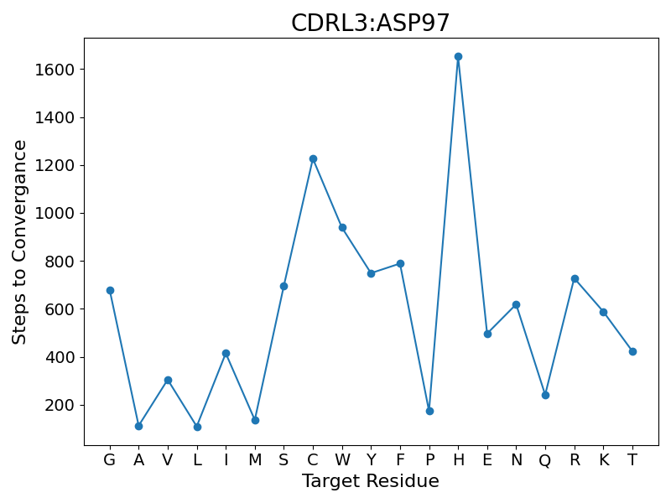
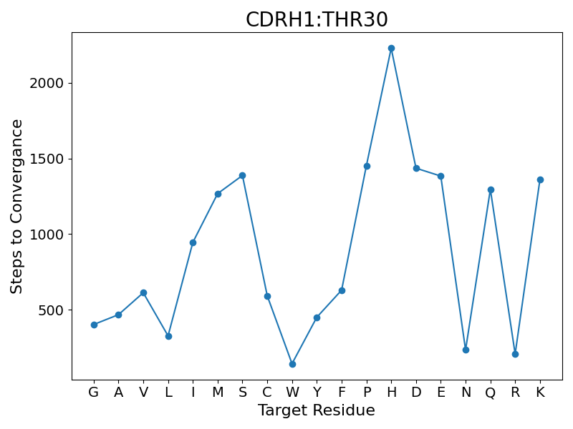
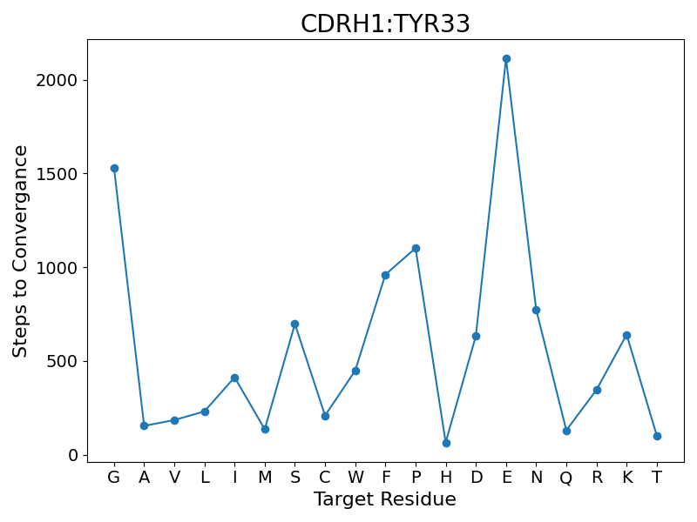
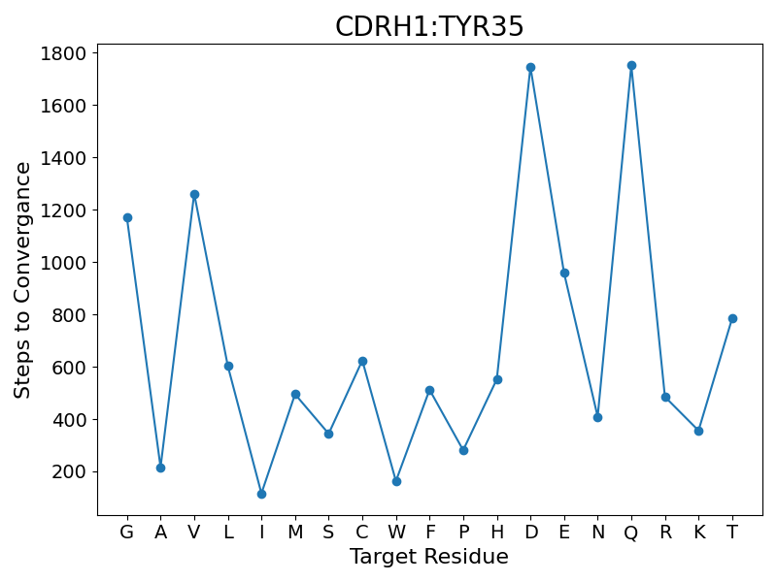
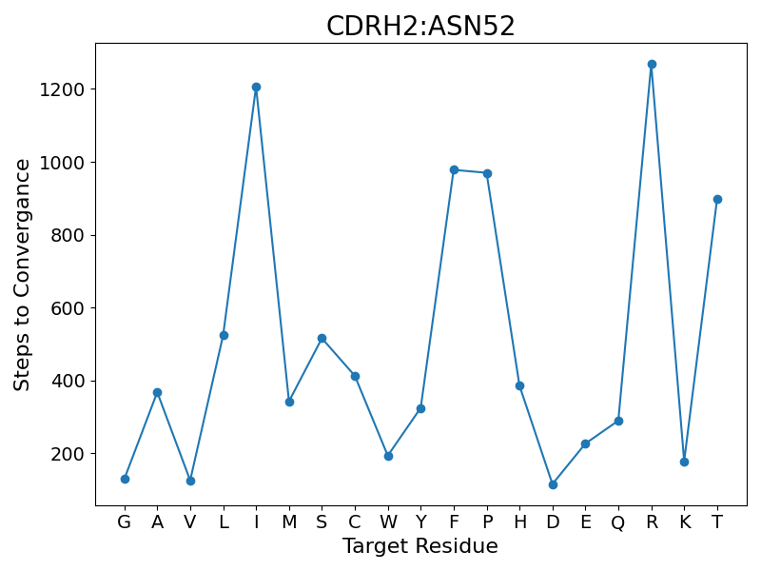
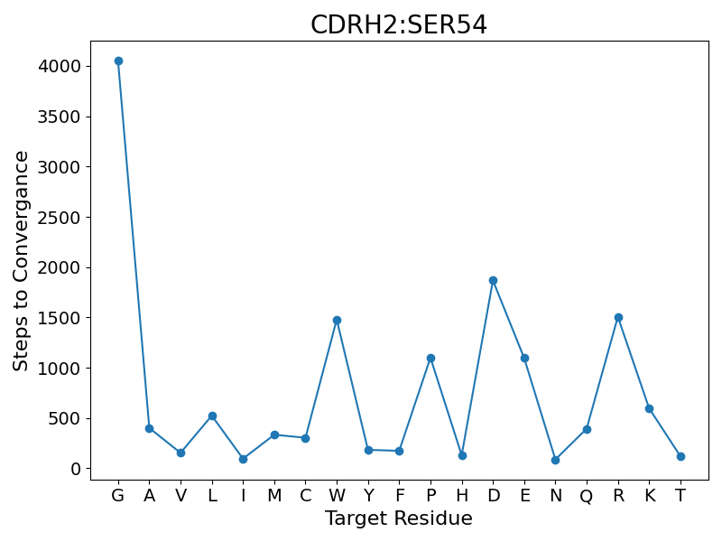
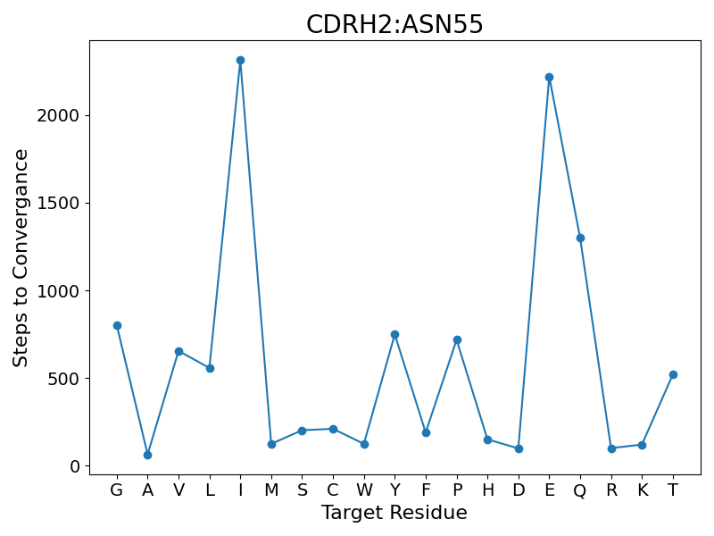
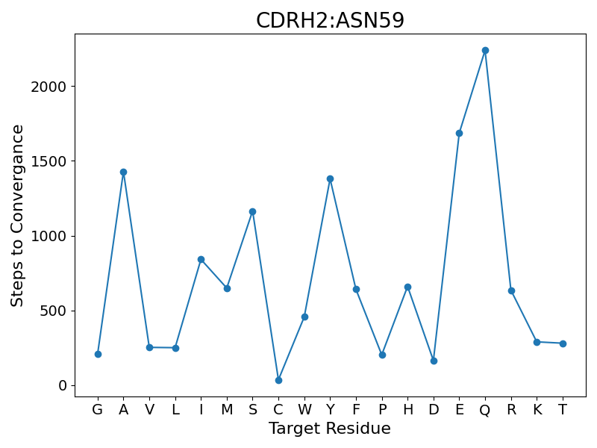
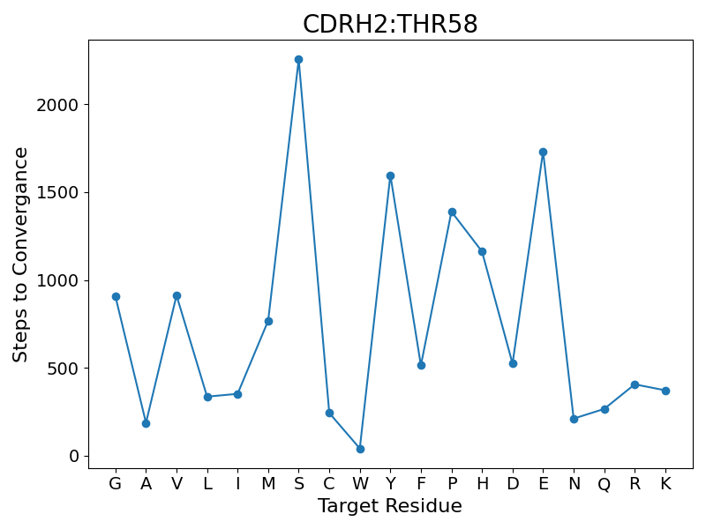
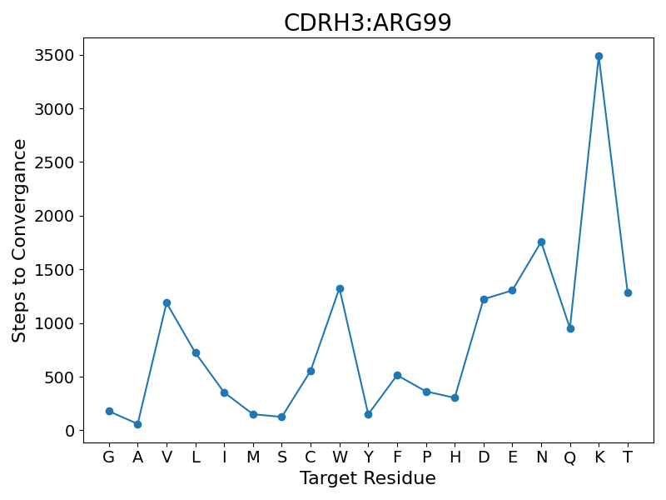
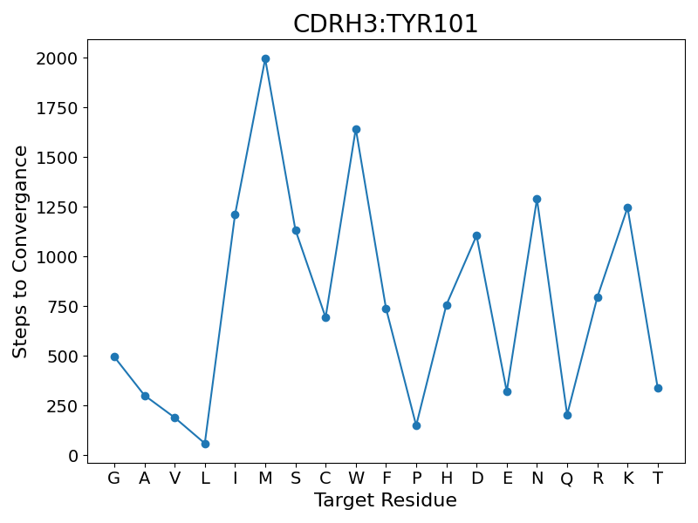
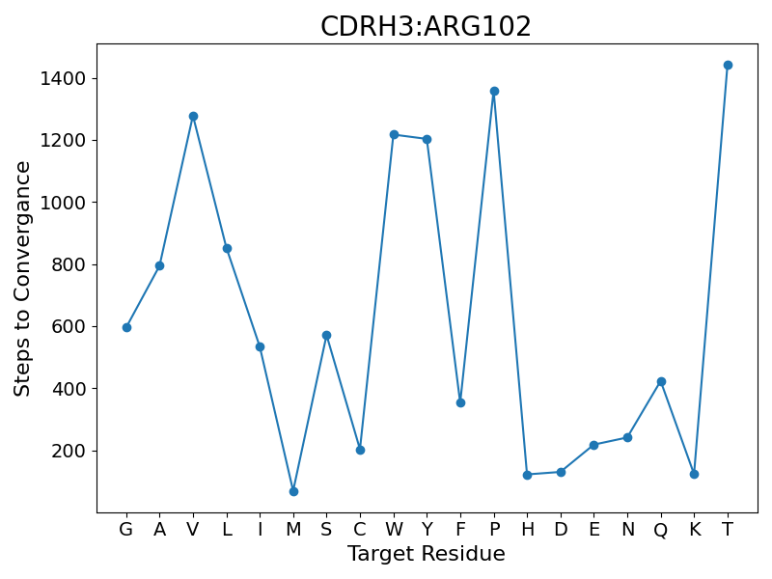
Somatic Hypermutations: Designing Hyper PD 1 inhibitors through Reinforcement Learning
Balakrishna Prabhu B N*, Namita Menon*, Dr. Nithya Ramakrishnan, Prof. Subhashini Srinivasan
Institute of Bioinformatics and Applied Biotechnology - Biotech Park, Electronics City Phase 1, Electronic City, Bengaluru, Karnataka 560100
*Authors have contributed equally to this work
ABSTRACT
BACKGROUND AND MODEL
CHALLENGES AND FUTURE WORK
Antibody diversity in response to an invading infection is profound. The process by which the diversity is created from our genome is even more incomprehensible. The numerous combinations of V,D,J regions of the genome along with somatic hypermutation perfected by B-cells on-demand, takes care of the diversity in paratopes on the antibody required to fight known and any unknown infection in the future. Wow!
Currently, there are several humanized single-chain antibodies representing the paratopes from the monoclonal against many endogenous antigens in the market. One of them is pembrolizumab designed to inhibit PD1-based signaling to boost immune response in cancer patients. The crystal structure of PD1-pembrolizumab and hundreds of other antibody-antigen complexes are now known.
During Somatic Hypermutations, an activated immune cell that binds partially to an antigen, clones and mutates repeatedly at a higher rate and competes for better binding with the antigen. We model this process using Reinforcement Learning (RL) and show how pembrolizumab can learn to bias its mutations so that it can achieve better binding with the PD1 antigen. Thus the proposed RL model will help in designing a more efficient PD1 inhibitor as well as other antibodies corresponding to various antigens, guided by the RL model.
Antibodies against antigens are created by VDJ Recombination followed by Somatic Hypermutation (SHM) leading to high-affinity monoclonal antibodies.
Pembrolizumab (antiPD1), a monoclonal antibody enhances the immune system in cancer patients by blocking the PD-1 pathway.
Reinforcement Learning (RL) is a Machine Learning technique that models the sequential decision making of an agent as Markov Decision Processes
By modeling the SHM as a RL model, we explore a method to design very high-affinity antibodies against antigens
As a case-study, through the RL model, we attempt to design a very high affinity antiPD1 through sequential mutations of amino acids interacting with PD-1 (5GGS), guided by energetics.
Attempts to use Deep Learning to design suitable antibodies against different antigens is an emerging area. One such effort [2] harnesses the highly diverse CDRH3 region, one of the six interacting loops, using GPT on primary sequences as the policy for an RL agent.
Here, the strategy to compute a high-affinity antibody using an RL model is by mimicking somatic hyper mutation (SHM) on a known antiPD1-PD1 complex including the entire paratope, which is a simplest representation of the complex biological process.
By employing RL and using the effort involved in accommodating a mutation via energy minimisation as the policy function, our work attempts to mimic the natural SHM process towards designing the high-affinity antibody.
In future, more generalised antibody design by harnessing the diversity from VDJ by recombination together with natural bias in SHM will be integrated via Deep Q Learning.
DESIGN AND WORKFLOW
AntiBody
(Agent)
Figure 2 (a)
Chain A : antiPDI light chain variable region (PemVL)
Chain B : Pembrolizumab heavy chain variable region (PemVH)
Chain C : Programmed cell death protein 1 (PD 1-Antigen)
Reward (Effort towards energy minimisation)
Mutations
(Actions)
Light chain Heavy Chain
CDRL1: RASKGVSTSGYSYLH CDRH1: KASGYTFTNYYMY
CDRL2: YLASYLES CDRH2: GINPSNGGTN
CDRL3: BBDABPPPB CDRH3: ARRDYRFDMGFDY
Antigen
(Environment)
Figure 1: Left-PDL1 mediated signaling to stop the immune response,
Right: Stimulating immune response by blocking PD1 mediated signaling with pembrolizumab (antiPD1)
Figure 2 (a) : Reference crystal structure of Pembrolizumab (PDB ID: 5B8C), (b) A schematic diagram of interactions between PD1 and antiPD1. Direct protein/protein hydrogen bonds are in blue;water-mediated hydrogen bonds are in green; and salt bridges are in red [2]
MUTATION PATTERNS
Q-Table
STATES
ACTIONS | R1 -> A | R1 -> C | ….. | R17-> W | R17 -> Y
A32,A34,A53,A57,A95,A97,B30,B33,B35,B52,B54,B55,B58,B59,B99,B101,B102 S, Y, Y, Y, S, D, T, Y, Y, N, S, N, T, N, R, Y, R
A32,A34,A53,A57,A95,A97,B30,B33,B35,B52,B54,B55,B58,B59,B99,B101,B102 S, Y, Y, Y, S, D, T, Y, Y, N, S, N, T, N, R, Y, A
. .
A32,A34,A53,A57,A95,A97,B30,B33,B35,B52,B54,B55,B58,B59,B99,B101,B102 S, Y, Y, Y, S, D, T, Y, Y, N, S, N, T, N, R, Y, D
Unmutated Antibody
(Agent)
PDB Mutator Script
(Pymol)
Energy Minimization
(Gromacs)
Number of steps to converge
(Reward for the Q-Table)
Final Antibody
(Result)
End | Continue
Next Generation Antibody
(Agent)
Updating the Q-Table
Action Predicted by the Q-Table
Q-Table Used To Predict the Next Action (Mutation).
Agent : Antibody (Pembrolizumab)
Actions : (Mutations across 17 residues (17 X 20 = 340) , No mutation
Multiple actions are allowed (action branching)
States : One of the possible 340 configurations of the antiPD1 structure
Reward : Function of no. of steps (n) towards Energy minimisation (EM)
If 10 < n <= 50, reward = +10
If 50 < n <= 200, reward = +5
If 200 < n <= 1000, reward = -5
If 1000 < n <= 2000, reward = -10
If n < =10, Stop : one of the best configurations
If n > 2000, Stop: kill the agent
Cloning of agents when reward is +10. (one agent clones into two agent)
Choice of Reward Function: Mutations across the residues lead to diverse configurations. The Energy Minimisation (EM) process employs the Steepest Descent and Conjugate Gradient algorithms to lead to a relaxed configuration. The reward in RL is calculated as a function of the no. of steps in the Conjugate Gradient algorithm of EM for every state (antiPD1 configuration). Fewer steps towards stability indicate a more favorable configuration.
Figure 3: In each panel one amino acid in antiPD1 is replaced with other 19 amino acids (x-axis) with y-axis representing the steps taken by energy minimization to converge using the AMBER ff99SB-ILDN force field and conjugate gradient. The positions mutated in each panel is from antiPD1 in Figure 2b shown interacting with PD1. In Figure 2a these amino acids are shown in light chain (red) and heavy chain (Pink) in line representation. The assumption is that the steps taken for convergence reflects the difficulty in accommodating a mutation in respective environments.
ACKNOWLEDGEMENT
REFERENCES
We would like to thank Prof. H Subramanya, Prof. N Yathindra, Prof. Sanjay Chandrashekaran and Dr. Shashi Gujar for their constant support and encouragement. We acknowledge IBAB for providing necessary equipments and resources to conduct the study. This study is supported by Dept. of electronics, IT, BT and S&T, Government of Karnataka. We would also like to extend our gratitude to the faculty of IBAB and Ms. Apoorva Ganesh for their timely support and guidance.
Horita, Shoichiro, et al. "High-resolution crystal structure of the therapeutic antibody pembrolizumab bound to the human PD-1." Scientific reports 6.1 (2016): 35297.
Xu, Xiaopeng, et al. "AB-Gen: Antibody Library Design with Generative Pre-trained Transformer and Deep Reinforcement Learning." Genomics, Proteomics & Bioinformatics (2023).
Mason, Derek M., et al. "Optimization of therapeutic antibodies by predicting antigen specificity from antibody sequence via deep learning." Nature Biomedical Engineering 5.6 (2021): 600-612.
Nosrati, Masoumeh, and Mohammad Reza Housaindokht. "New insights into the effect of mutations on affibody-Fc interaction, a molecular dynamics simulation approach." Journal of Structural Biology 215.1 (2023): 107925.

